Slide 1



How Transformers
LLM work
Ing. Fabio Antonini
Software Engineer
Introduction to Machine Learning for Engineers
Notes:
Welcome to How Transformer LLMs Work.
In this course, you learn about the main components of the LLM transformer architecture that has transformed the field of language processing.
Our hope is that as you leave this course, you will be able to read through papers describing models and understand the details that are used to describe these architectures.
And these intuitions will help you use LLMs better too.
Let me introduce the main topic of this course, the transformer.
The transformer architecture was first introduced in the 2017 paper, *Attention is All You Need* by Ashish Vaswani and others for machine translation tasks.
The idea was to input an English sentence and have the network output a German sentence.
The same architecture tends to be great at inputting, say, a prompt and outputting a response to that prompt like a question and the answer to that question.
And so this helped herald the early rise of large language models.

Slide 2

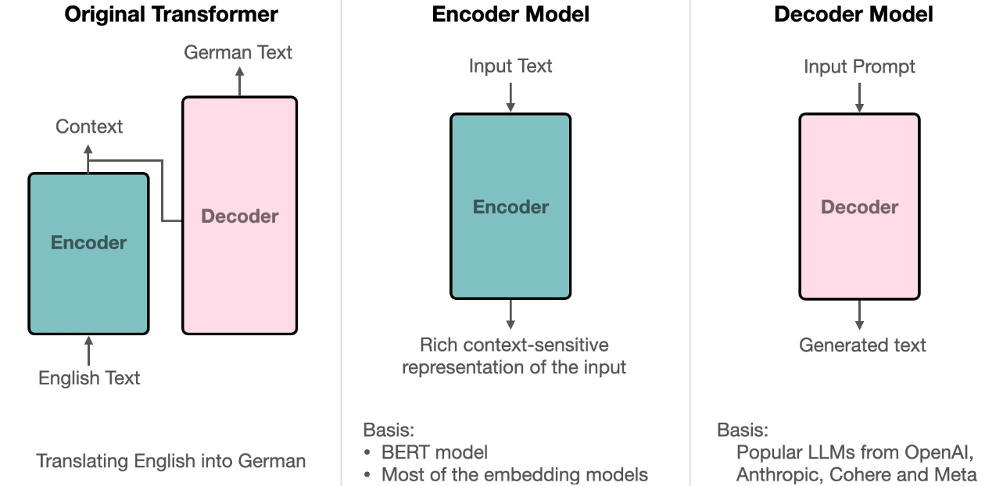

Transformer Architecture
Key Points
The original Transformer has two main components:
Encoder and Decoder
Encoder
  Processes the full input sequence
  Builds rich, context-aware representations
  Foundation of BERT and most embedding models (RAG)
Decoder
  Uses encoded context to generate output
  Performs text generation (summarization, Q&A, code)
  Basis of most modern LLMs (OpenAI, Anthropic, Cohere, Meta)
Encoder–Decoder design is the foundation of modern language models
Notes:
The original transformer architecture consisted of two main parts.
It was an encoder and decoder.
Consider translating English into German, the encoder preprocesses the entire input English text to extract the context needed to perform the translation.
Then the decoder uses the encoder context to generate the German.
The encoder and the decoder form the basis for the models used in many language models today.
The encoder model provides rich, context-sensitive representations of the input text, and is the basis for the BERT model and most of the embedding models using RAG applications.
The decoder model performs text generation tasks such as summarizing text, writing code, answering questions, and is the basis for most popular LLMs, such as those from OpenAI, Anthropic, Cohere, and Meta.

Slide 3
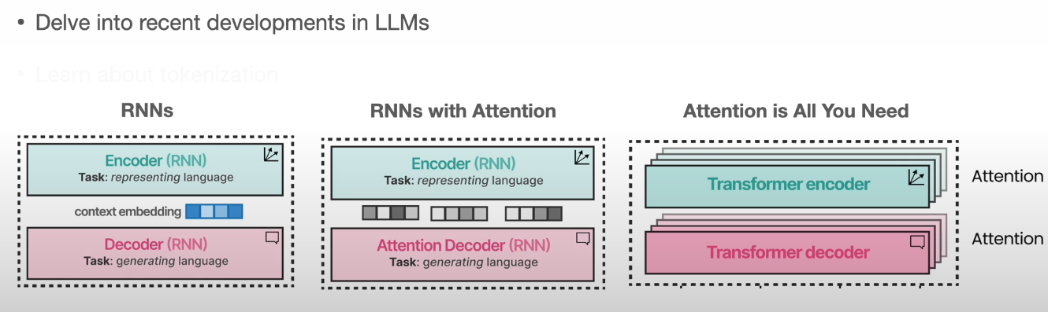
Course Outline – Recent development in LLMs
Notes:
Let's go over what you learned in this course.
You first delve into recent developments in LLMs to see how a sequence of increasingly sophisticated building blocks led to the modern transformer.

Slide 4
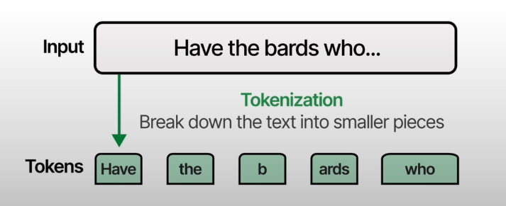
Course Outline – Tokenization
Tokenization, which consists of taking text and breaking it down into tokens that comprise words or word fragments.​
Notes:
You then learn about tokenization, which consists of taking text and breaking it down into tokens that comprise words or word fragments.
They can then be fed into the LLM.

Slide 5
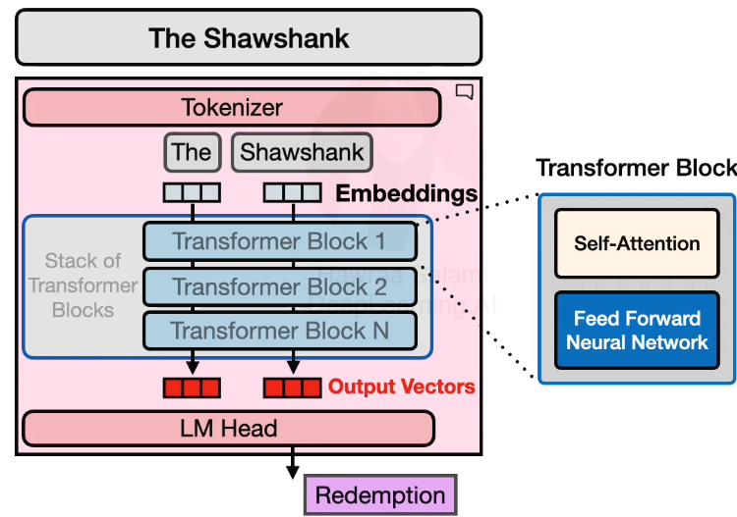
Course Outline – Decoder-Only Transformer
Generation Process
Focus on decoder-only architecture
(used in modern LLMs)
A generative model:
    Takes a text prompt
    Generates output one token at a time
Generation Pipeline
Token Embedding
    Each input token is converted into a
    numerical embedding vector
Transformer Blocks
    Embeddings pass through a stack of
    transformer layers
    Each block contains:
        Self-attention layer
        Feed-forward neural network
    Designed for scalability on GPUs
Language Modeling Head
    Final layer
    Converts transformer outputs into the next predicted token
Notes:
After that, you gain intuition about how the transformer network works, focusing on the decoder-only models.
A generative model takes in a text prompt, and it generates a text in response by generating one token at a time.
Here's how the generation process works.
The model starts by mapping each input token into an embedding vector that captures the meaning of that token.
After that, the model parses these token embeddings through a stack of transformer blocks, where each block is a specific neural network architecture that is designed to learn flexibly from data and also scale well on GPUs.
So you learn how each block is made up of an attention layer and a feed-forward network.
The model then uses the output vectors of the transformer blocks and passes them to the last component, the language modeling head, which generates the output token.
By the way, I know that Transformers might seem a little bit like magic to some people, and in fact, one common experience after you learn how Transformers work is, I've heard some people go, oh, that's it.
And I think part of the reason for that reaction is the magic of LLMs actually comes from two parts:
One, the transformer architecture, which you learn is well worth learning.
And second, all the incredibly rich data that the models learn from.
So while the magic of LLMs comes not just from the transformer architecture, but also from the data, having a solid intuition of what this architecture is doing will give you better intuitions about why they behave in certain ways, as well as how to use them.

Slide 6
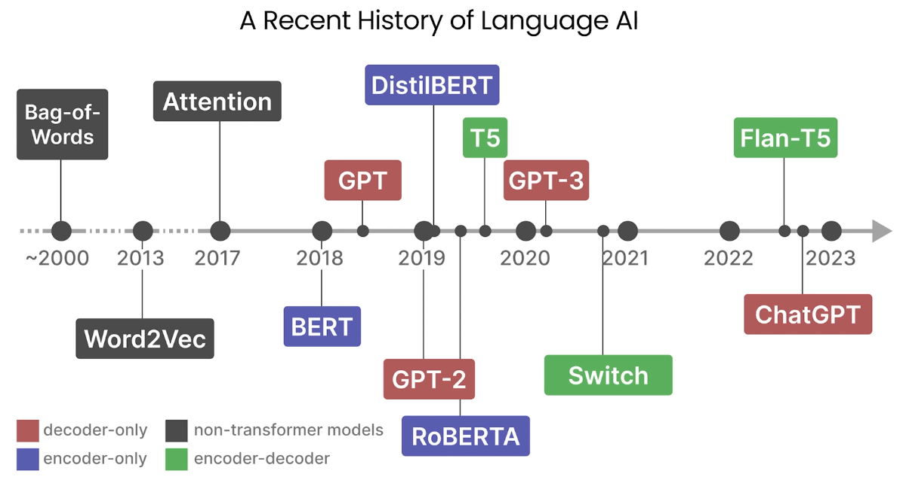
Language Models - History
Notes:
You will learn the evolution of how language has been represented numerically.
We'll start with bag of words, an algorithm that represents words as large sparse vectors or arrays of numbers, which simply record the presence of words.
Then Word2Vec, whose word representations capture the meaning of words in the context of a few neighboring words.
Finally, transformers, whose dense vectors capture the meaning of words in the context of a sentence or a paragraph.
All right. Let's jump in.
I have some illustrations that will help clarify these ideas.
Although we will explore a more recent history of language AI and language models, it is important to understand where we started.
Earlier techniques such as bag-of-words and Word2Vec have been arguably the foundation of what we're using today.
Although they lack contextualized representations, they are often a good baseline to start with.
We call these non-transformer models since today's models are typically powered solely by transformer models, in contrast to these strong baselines.
Then we have encoder-only models, which are great at representing language in numerical representations.
In contrast, decoder-only models are generative in their nature.
Their main usage is to generate text.
And finally, we have encoder-decoder models that attempt to get the best of both worlds.
You will learn about these non-transformer models, encoders, decoders and how they relate, as we explore this more recent history of language AI.

Slide 7
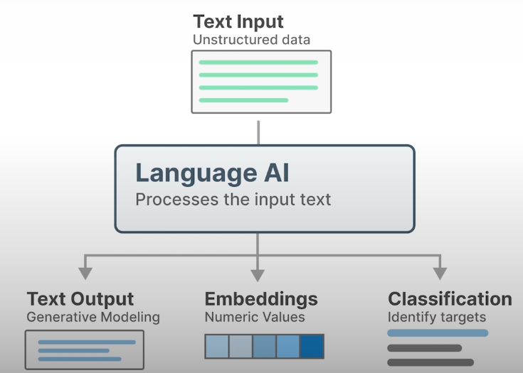
Language Models - Language and AI
Key Ideas
Language is difficult for computers because it is unstructured
Raw text loses meaning when reduced to bits or individual characters
A central goal of language AI is to create structured representations of text
Structured representations enable tasks such as:
    Text generation
    Numerical embeddings
    Text classification
Many AI applications rely on transforming language into usable computational forms
Notes:
Language, however, is a tricky concept for computers.
Text is unstructured in nature and loses its meaning when represented by zeros and ones or individual characters.
As a result, throughout the history of language AI, there has been a large focus on representing language in a structured manner so that it can more easily be used by computers.
From generating text, to creating numerical representations, and classifying textual inputs.
These are just a few of the numerous tasks you can do with language AI.

Slide 8
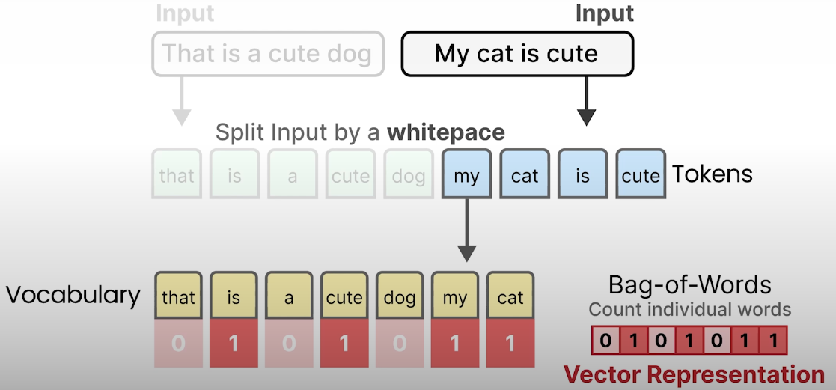
Language Models - Bag of Words
Notes:
At the start of this language AI field, the focus was mainly on representing language to analyze unstructured data.
A first and still very relevant method is by representing language as a bag-of-words.
Imagine you have some input text, "That is a cute dog".
To represent this sentence you can break it up into smaller pieces.
To do so, you split the text into words by separating them through a whitespace.
This process of converting the input text into pieces is called tokenization, and each individual word is called a token.
Note that a token can be even smaller than an entire word, but we will go through tokenization in the next lesson in more detail.
You can perform the same tokenization process with another document, "My cat is cute."
Although similar documents, they do contain different words and have a different meaning.
Now that you are left with two sets of tokens, you can create something called a vocabulary.
This vocabulary contains all unique words or tokens found in both input documents.
As such, the vocabulary will contain fewer words than the amount of tokens that were generated.
And we typically refer to the number of tokens or words in the vocabulary as the vocabulary size.
To then represent one of our inputs with numerical values, let's focus a bit on our second input, "My cat is cute."
This input has four tokens that match with some of the words in the vocabulary, but not all.
You can then count how often a certain token appears in the vocabulary that we already created.
In this case, each token appears once.
However, you will also have to take note of the words in the vocabulary that do not appear in the input.
A sentence not only gives meaning to the words it contains, but also the words it doesn't.
Now that you have counted how often the words or tokens of our input appear in the vocabulary, you have created your numerical representation.
This is called a bag-of-words, and does nothing more than counting individual words that appear in the vocabulary.
Therefore, the numerical representation of "My cat is cute" is 0101011, in that specific order. The order is important as it allows us to compare different sentences to one another.
In practice, we call this a vector representation, a list of numerical values that represents the input.
In this example, these values are counts and have an explicit meaning, namely, the number of times a word in the vocabulary appears in the input.
Vector representations, in more complex and advanced models, typically do not have such an intuitive meaning, and have values between 0 and 1.

Slide 9
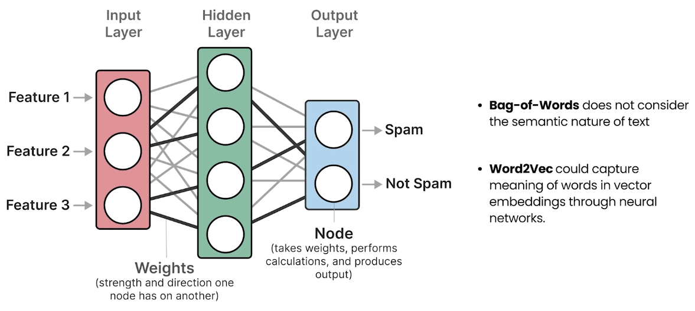
Vector Embeddings
Notes:
Let's explore how these more complex vector embeddings are created.
Note that bag-of-words, although an elegant approach, has a flaw.
It considers language to be nothing more than an almost literal bag-of-words, and ignores the semantic nature or meaning of text.
Released in 2013, Word2Vec was one of the first successful attempts at capturing the meaning of text in embeddings.
To do so, Word2Vec learned semantic representations of words by training on vast amounts of textual data, like the entirety of Wikipedia.
To generate these semantic representations, Word2Vec leverages neural networks.
These networks consist of interconnected layers of nodes that process information.
Neural networks can have many layers, where each connection has a certain weight depending on the inputs.
These weights are often referred to as parameters of the model.

Slide 10
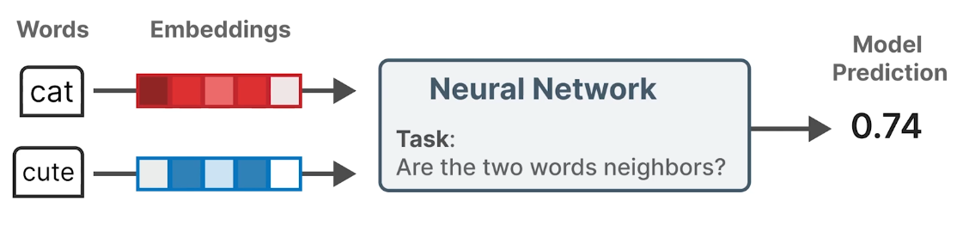
Word2Vec Training
Word2Vec – How Embeddings Are Learned
Each word is initialized with a random vector embedding
The model is trained on word pairs from real sentences
It learns to predict whether two words are likely neighbors
Words appearing in similar contexts become closer in vector space
Final embeddings encode semantic relationships between words
Notes:
Using these neural networks, Word2Vec generates word embeddings by looking at which other words they tend to appear next to in a given sentence.
You start by assigning every word in your vocabulary a vector embedding, say five values for each word, initialized with random values.
Then in every training step, you take pairs of words from training data, and the model attempts to predict whether or not they are likely to be neighbors in a sentence.
During this training process, Word2Vec learns the relationship between words and distills that information into the embedding.
If two words tend to have the same neighbors, their embeddings will be closer to one another and vice versa.
The resulting embeddings capture the meaning of words.
But what exactly does that mean?

Slide 11
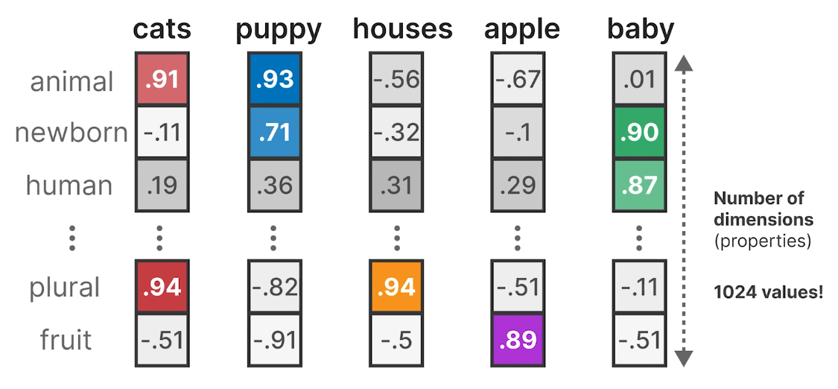
Word2Vec Example
Notes:
To illustrate this phenomenon, let's explore an example.
Assume that you have an embedding for the word "cats".
This embedding generates values between -1 and 1.
Embeddings attempt to capture meaning by representing the properties of words.
For instance, the word "cats" might score low on the properties newborn, human, and fruits, while scoring high on the properties animal and plural.
The number of properties or values an embedding has is called the number of dimensions, and is generally a fixed size.
The same can be said for other words, such as puppy, which scores high on animal and newborn, but low on all others.
By doing this for a number of words, you can use these values to get a proxy of the meaning of these words.
Note that the number of dimensions can be quite large, and it is not uncommon to see embeddings with more than a thousand values.
However, in practice, you do not actually know what these properties exactly represent, as they are learned through complex mathematical calculations.

Slide 12
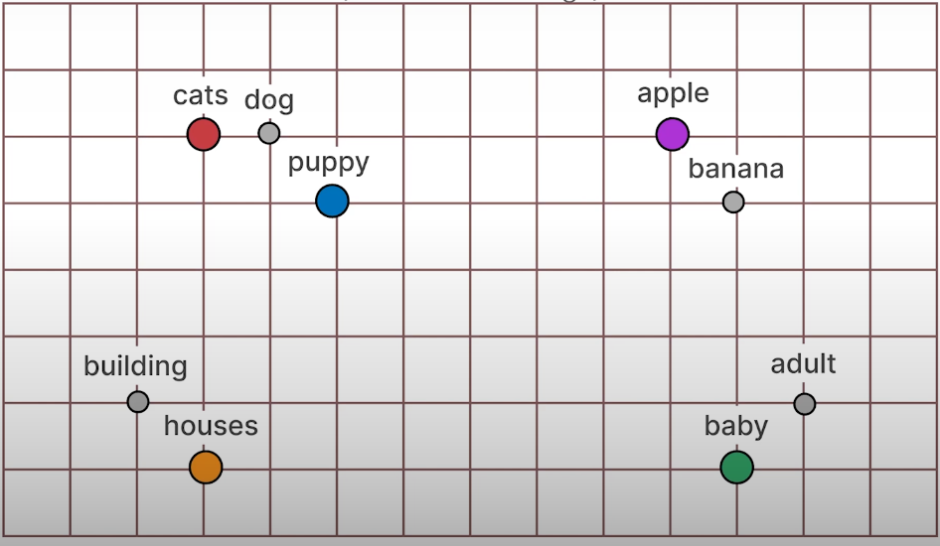
Word2Vec - Visualization
Comparing Word Embeddings
Embeddings enable quantitative comparison between words
Words with similar meanings cluster together in vector space
Dissimilar words are farther apart
Similarity relationships depend on the training data used
Notes:
These properties do allow you to compare embeddings and therefore words with one another.
Words with similar meaning will be grouped together, whereas different words are further apart.
How similar or dissimilar certain words are depends on the training data.

Slide 13
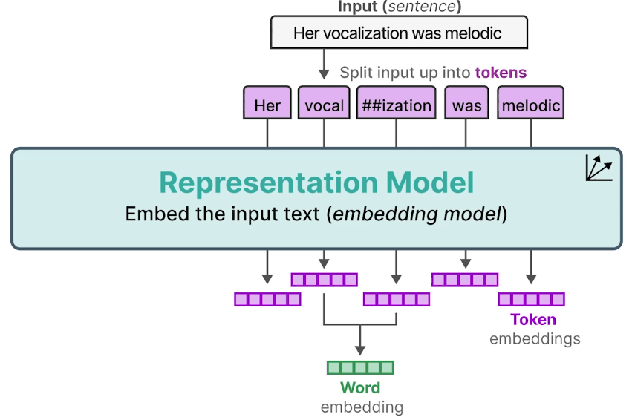
Word Embeddings
Representation Models and Tokenization
There are many types of embeddings beyond word embeddings
Models like Word2Vec are called representation models because they convert text into numerical values
Text is first tokenized into smaller units (tokens)
Tokenization is not always whitespace-based; words can be split into subword tokens (e.g., vocal + ization)
Tokenizers use a fixed vocabulary, so unseen words are decomposed into known subword units
The model generates embeddings for each token
Word embeddings can be obtained by combining (e.g., averaging) token embeddings
Notes:
Thus far we explored word embeddings, but there are many types of embeddings that we can use.
When we talk about a model like Word2Vec that converts textual input to embeddings, we refer to it as a representation model, as it attempts to represent text as values.
Imagine that you have some input, for example, the sentence "Her vocalization was melodic."
Through tokenization, you can split the sentence up into tokens.
Note that this procedure is actually not splitting the input by white spaces.
The word vocalization is split up into vocal and ization.
The reason for this is that models that perform tokenization, also called tokenizers, have a fixed vocabulary.
As such, they cannot represent all words that exist, but sometimes have to find combinations of words.
You give the representation model these individual tokens, which in turn generates embeddings, one for each token.
Note that the word vocalization contains the tokens vocal and ization.
So when you average the embeddings of these tokens, you get a word embedding, as it now represents the entire word.

Slide 14
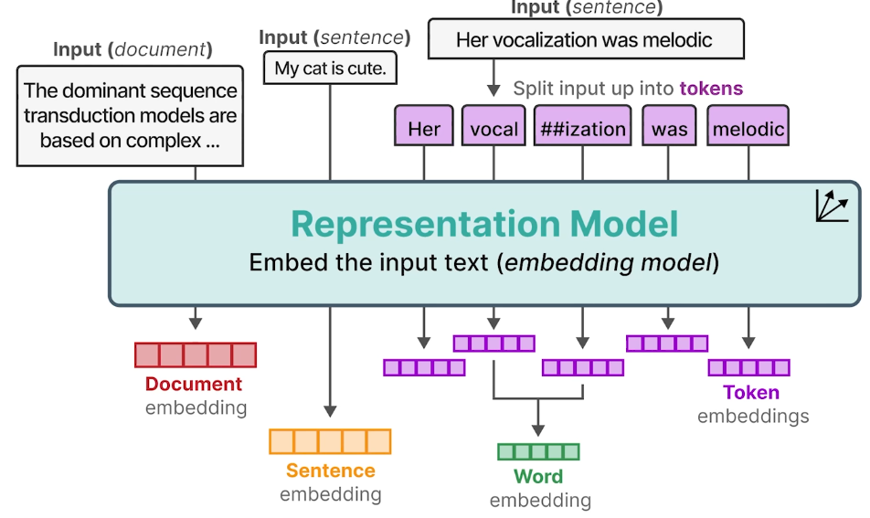
Sentence and Documents Embeddings
Beyond Word Embeddings
Embedding techniques extend to:
  Sentence embeddings
  Document embeddings
Many different types of embeddings exist
Next step: move from static embeddings to contextualized encoding and decoding
Notes:
Similar techniques can be used for entire sentences to create sentence embeddings, and the same for longer texts such as documents to create document embeddings.
These are just a few of the many embeddings that exist.
Let's how you can encode and decode contextualized information, rather than static representations.

Slide 15
Thank you for the attention
Fabio Antonini
Software Engineer
Fabio.antonini.1969@gmail.com

